Slide 1
Functional Testing
Functional testing techniques attempt to design those test cases which have a higher probability of making a software fail. These techniques also attempt to test every possible functionality of the software
Test cases are designed on the basis of functionality and the internal structure of the program is completely ignored.

Slide 2
BOUNDAR ANALYSISY VALUE
This is a simple but popular functional testing technique. Here, we concentrate on input values and design test cases with input values that are on or close to boundary values.
Minimum value
Just above minimum value
Maximum value
Just below maximum value
Nominal (Average) value

Slide 3
Example
These five values (1, 2, 50, 99 and 100) are selected on the basis of boundary value analysis and give reasonable confidence about the correctness of the program
The number of inputs selected by this technique is 4n + 1 where ‘n’ is the number of inputs.

Slide 4
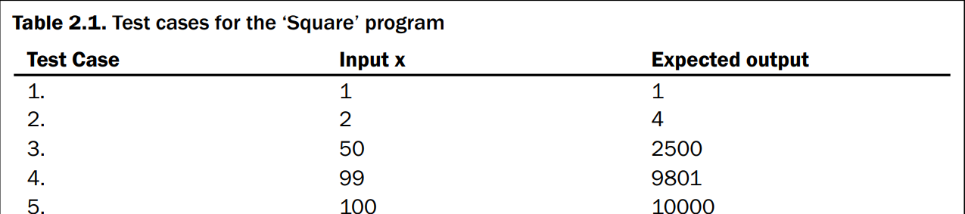
Example (Cont.)

Slide 5
Robustness Testing
This is the extension of boundary value analysis. Here, we also select invalid values and see the responses of the program. Invalid values are also important to check the behavior of the program. Hence, two additional states are added i.e. just below minimum value (minimum value – ) and just above maximum value (maximum value + ).
There are four additional test cases which are outside the legitimate input domain. Thus, the total test cases in robustness testing are 6n + 1, where ‘n’ is the number of input values

Slide 6
Robustness Testing
Minimum value
Just above minimum value
Just below minimum value
Just above maximum value
just below maximum value
Maximum value
Nominal (Average) value

Slide 7
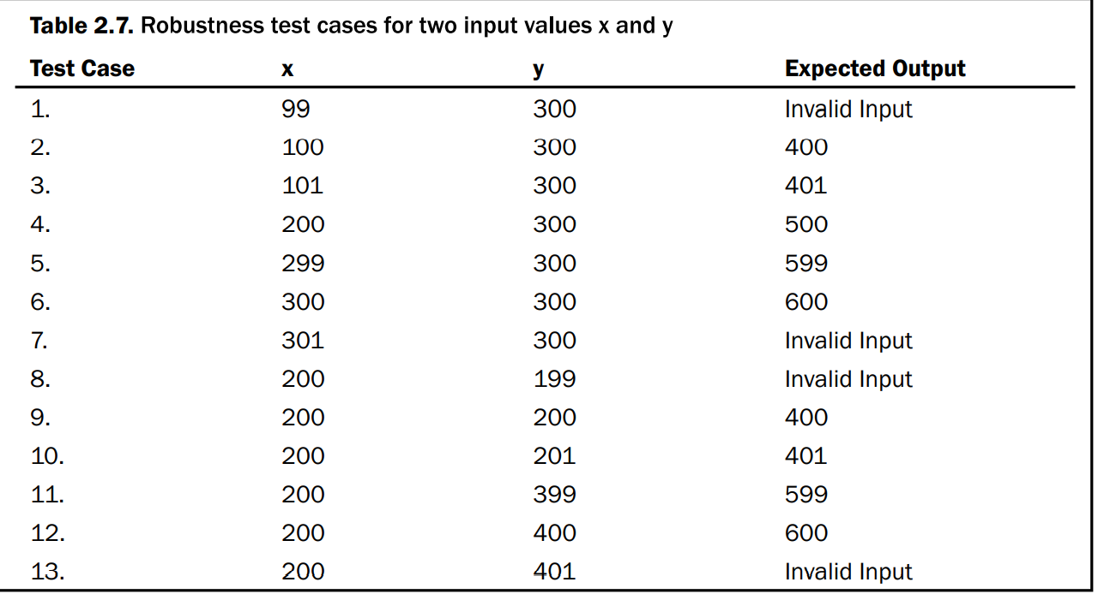
Example

Slide 8
Worst-Case Testing
This is a special form of boundary value analysis where we don’t consider the ‘single fault’ assumption theory of reliability. Now, failures are also due to occurrence of more than one fault simultaneously. The implication of this concept in boundary value analysis is that all input values may have one of the following:
Minimum value
Just above minimum value
Just below maximum value
Maximum value
Nominal (Average) value

Slide 9
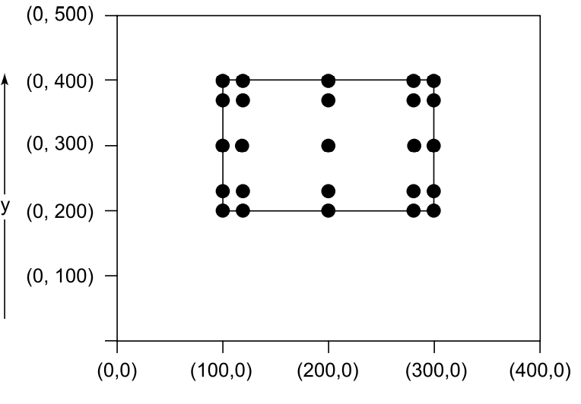
Example

Slide 10
Robust Worst-Case Testing
In robustness testing, we add two more states i.e. just below minimum value (minimum value– ) and just above maximum value (maximum value+ ).
We also give invalid inputs and observe the behaviour of the program
There are seven states
7^2= 49

Slide 11
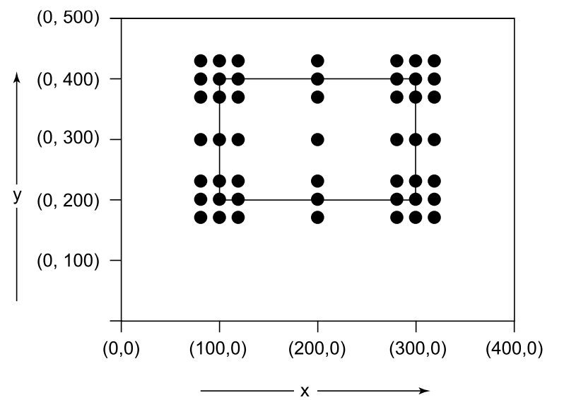
Example

Slide 12
EQUIVALENCE CLASS TESTING
We may divide input domain into various categories with some relationship and expect that every test case from a category exhibits the same behavior. If categories are well selected, we may assume that if one representative test case works correctly, others may also give the same results. This assumption allows us to select exactly one test case from each category and if there are four categories, four test cases may be selected. Each category is called an equivalence class and this type of testing is known as equivalence class testing.

Slide 13
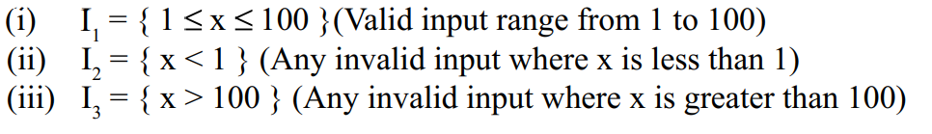
Creation of Equivalence Classes
The input domain equivalence classes for the program ‘Square’ which takes ‘x’ as an input (range 1-100) and prints the square of ‘x’

Slide 14
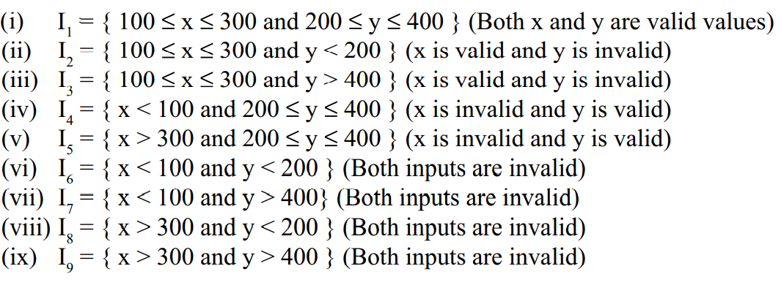
Cont.
The following equivalence classes can be generated for program ‘Addition’ for input domain: (i)

Slide 15
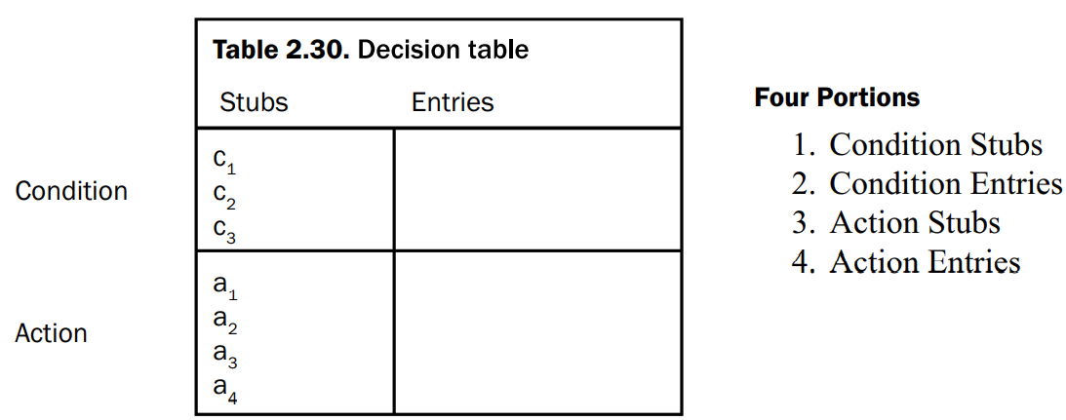
DECISION TABLE BASED TESTING
Decision tables are used in many engineering disciplines to represent complex logical relationships. An output may be dependent on many input conditions and decision tables give a pictorial view of various combinations of input conditions. There are four portions of the decision table and are shown in Table 2.30. The decision table provides a set of conditions and their corresponding actions.

Slide 16
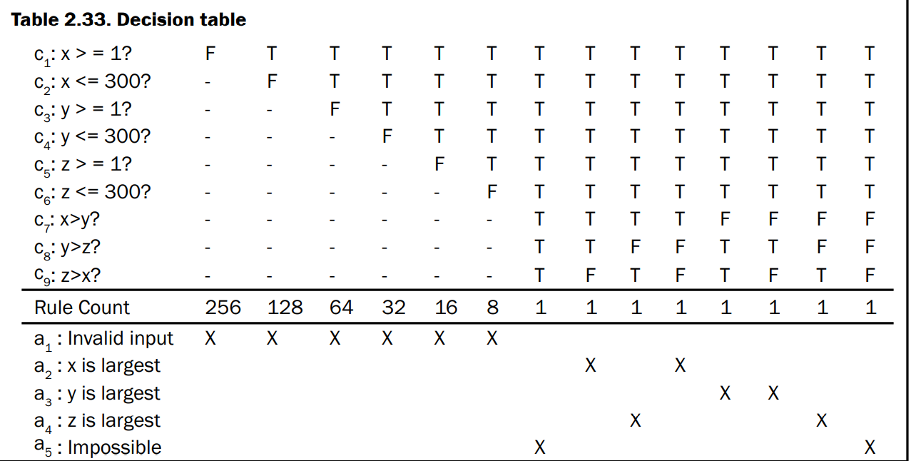
Determining of the largest amongst three numbers

